Slide 1
Enterprise Data Cleaning & ETL Orchestration Frameworks
Using Python, Apache Airflow & Streamlit

Slide 2
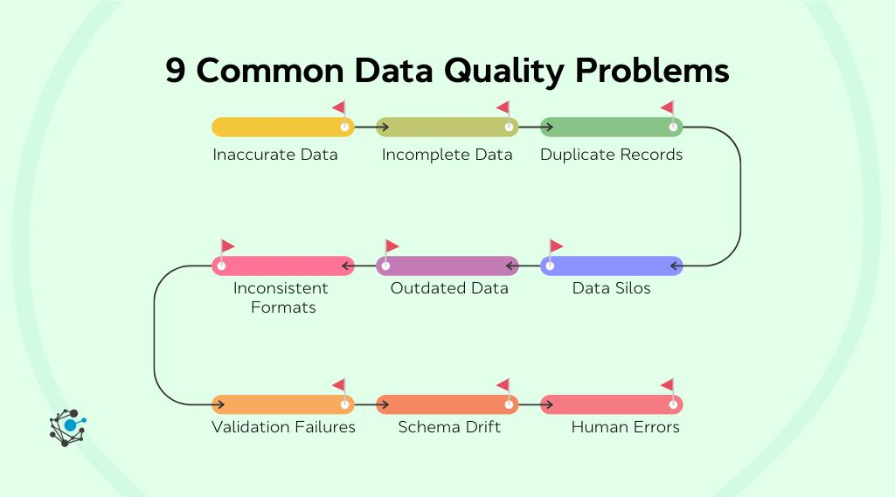
Problem Statement
Retail businesses generate large volumes of raw transactional data.
Challenges:
Data is unclean and inconsistent
Manual processing is time-consuming
No automated monitoring system
Lack of real-time insights
Solution:
Build an automated ETL pipeline with visualization.

Slide 3
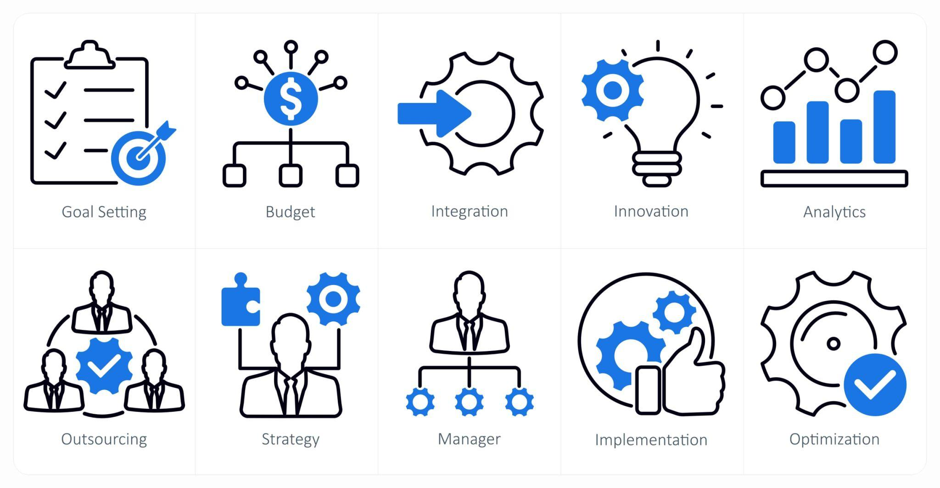
Project Objective
Objectives:
Automate data extraction, transformation,
and loading
Clean and standardize raw data
Store processed data in a database
Build a dashboard for business insights
Enable monitoring using Airflow

Slide 4
Tech Stack
Technologies Used:
Python (Core Programming)
Pandas (Data Transformation)
Apache Airflow (Workflow Orchestration)
PostgreSQL (Database)
Streamlit (Dashboard)
Docker (Containerization)

Slide 5
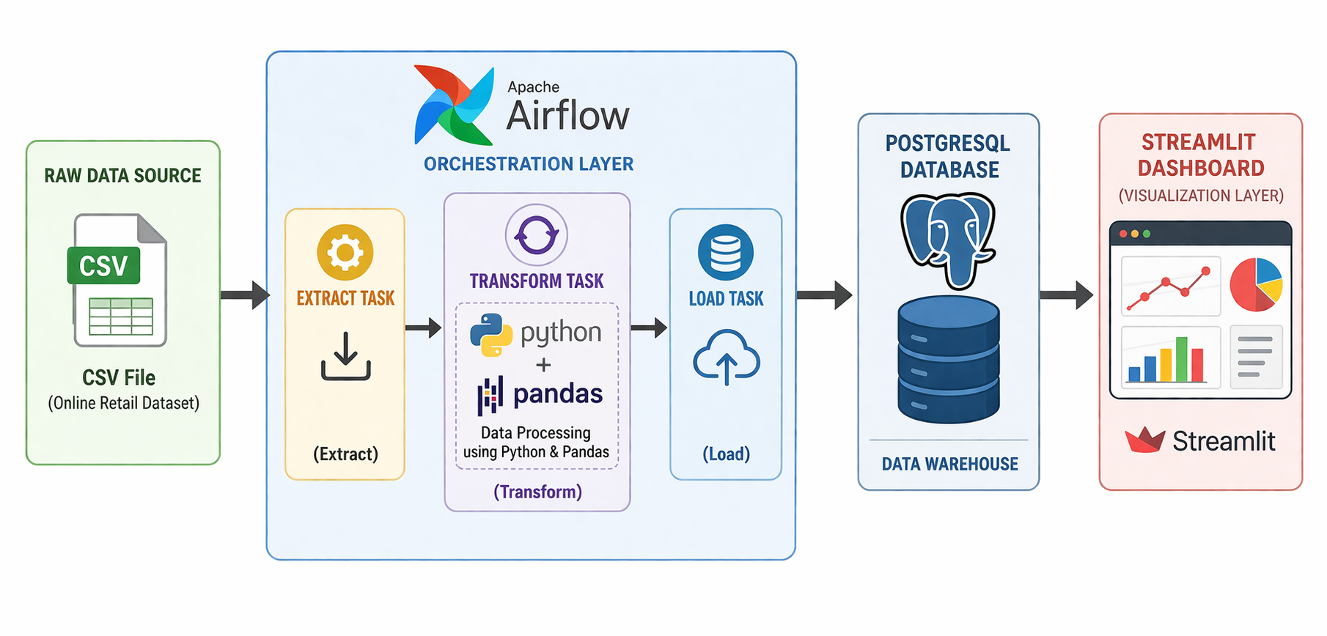
Architecture Diagram
Pipeline Flow:

Slide 6
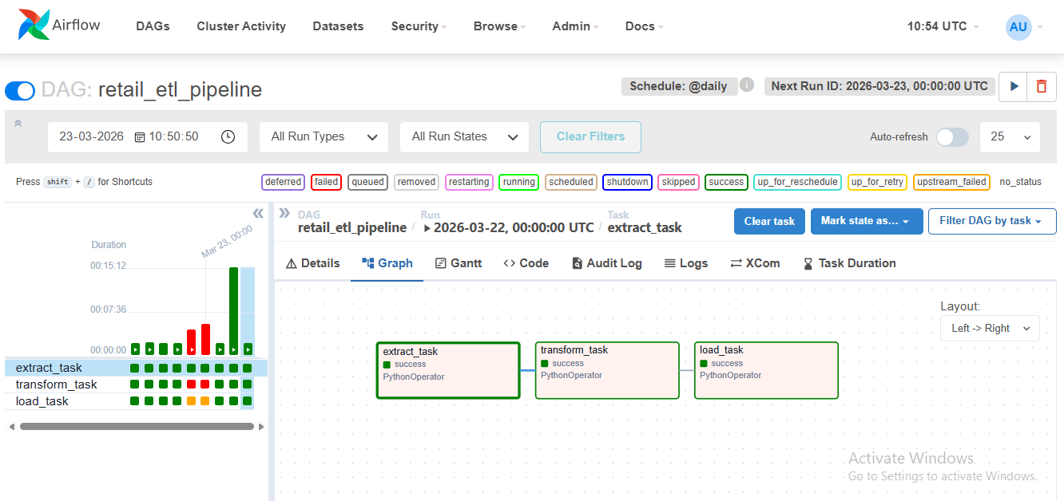
ETL Pipeline (Overview)
The pipeline consists of
three stages:
1. Extract
2. Transform
3. Load
Each stage is implemented
as an Airflow task.

Slide 7
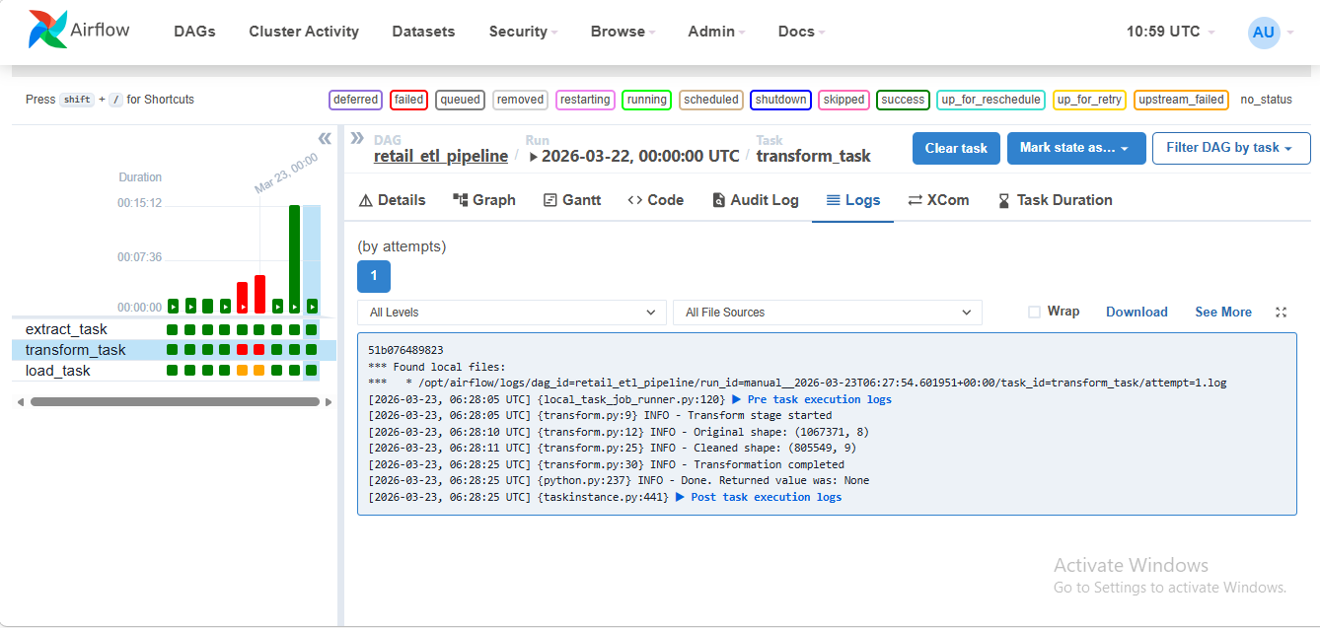
Extract & Transform
Extract:
Reads raw CSV file
Validates data availability
Transform:
Handles missing values
Converts data types
Removes invalid records
Creates new column: TotalAmount

Slide 8
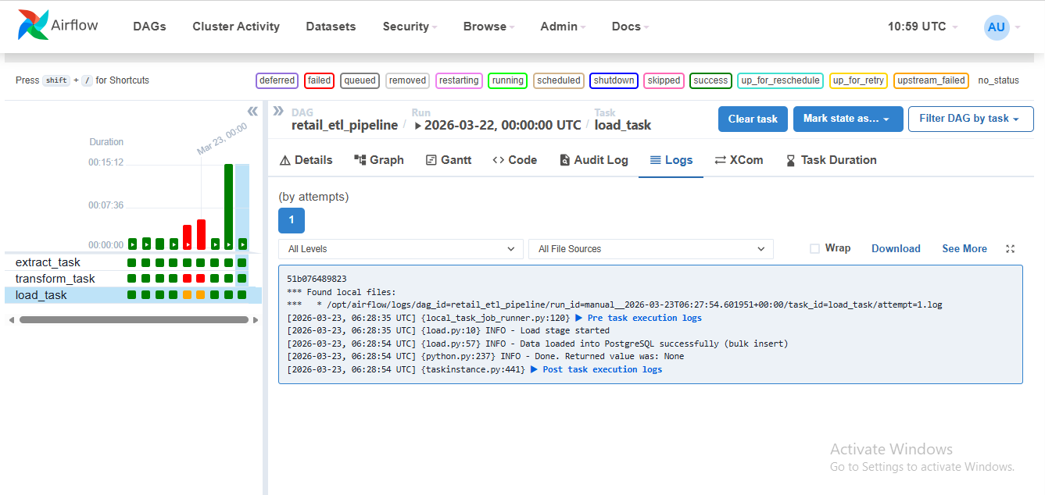
Load & Monitoring
Load:
Stores cleaned data into
PostgreSQL
Uses optimized bulk insert
Monitoring:
Airflow DAG scheduling
Retry mechanism on failure
Logging for debugging
Email alerts on task failure

Slide 9
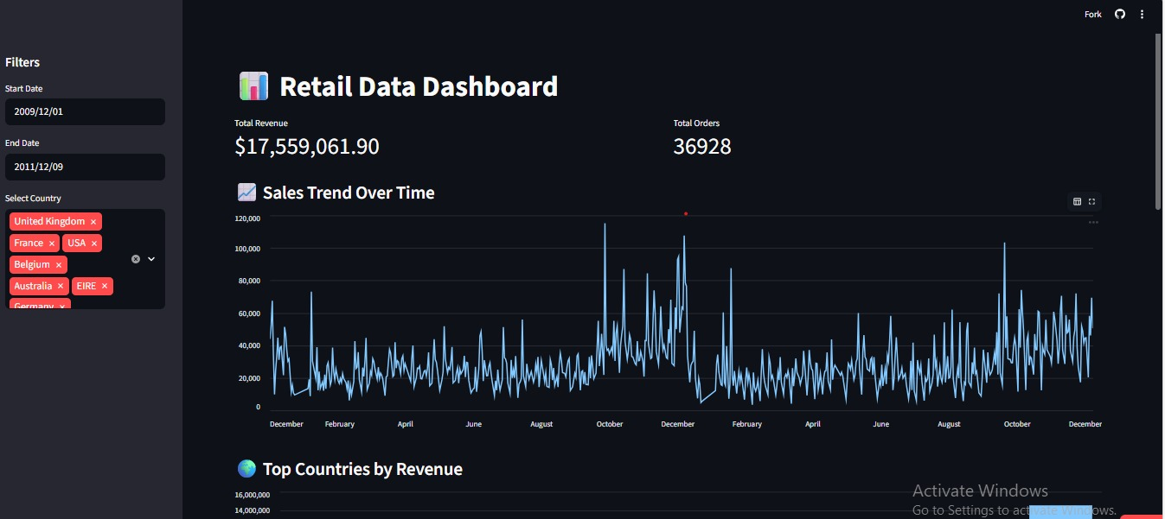
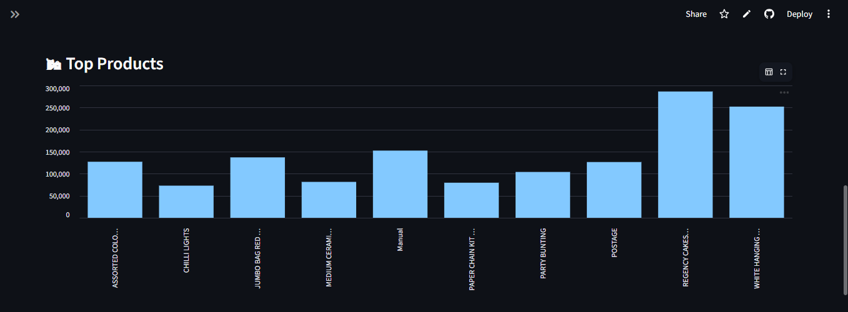
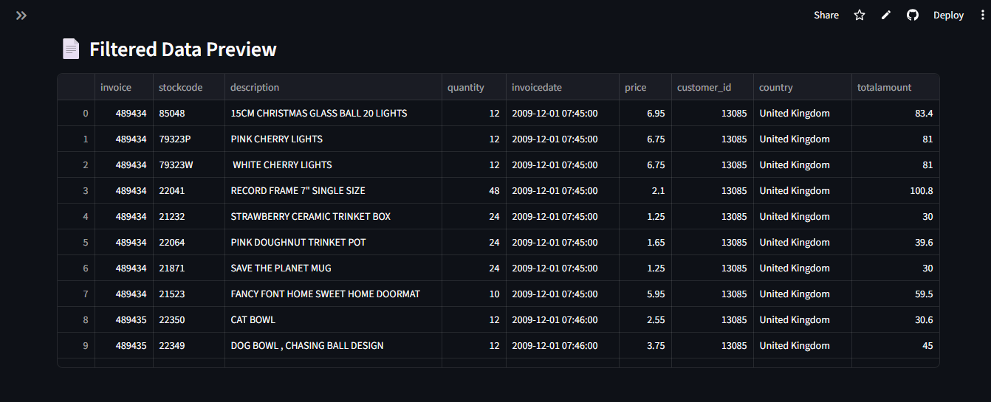
Dashboard
Interactive Dashboard Features:
Total Revenue & Orders (KPIs)
Sales trend over time
Top countries by revenue
Top products analysis
Filters (Date & Country)

Slide 10
Live Demo
Deployed using Streamlit Cloud
Live Dashboard:
https://etl-project-6yhxaiayboddqrusnjtdsh.streamlit.app/

Slide 11
Challenges & Solutions
Challenges:
File path issues in Docker
Column inconsistencies
Slow database loading
Solutions:
Mounted volumes correctly
Standardized column names
Used bulk insert for performance

Slide 12
Conclusion
Successfully built an end-to-end ETL pipeline
Automated data processing using Airflow
Created an interactive dashboard
Deployed project on cloud
Future Scope:
Real-time data processing
Cloud database integration
Advanced analytics dashboards

